Slide 1




Customer Investment Data
View in Power BI
By Satyashree Sahu Pawar

Slide 2
Project Description
This project aims to carefully study information about how customers invest their money. We want to find useful ideas from this data to help make better decisions. We will use a tool called Power BI to bring in, look at, and show the data. Our main focus is on important numbers, differences in how men and women invest, the connection between why people save and how they invest, how long investments last, how often people check on their investments, why people choose to invest, and where they get their information about investing.

Slide 3
Understanding Dataset
The data set is all about client data for inevestmnet details.
There are 24 columns and 41 rows.
There is no null data available.

Slide 4
Understanding the Data
- This dataset comprises client information pertaining to investment details.
- It includes 24 columns and 41 rows.
- Notably, there is no missing data in any of the entries.
- Refer to the details of each column below.
gender: The gender of the individual.
age: The age of the individual.
Investment_Avenues: Overall category for various investment options.
Mutual_Funds: Presence or absence of investments in mutual funds.
Equity_Market: Presence or absence of investments in the equity market.
Debentures: Presence or absence of investments in debentures.
Government_Bonds: Presence or absence of investments in government bonds.
Fixed_Deposits: Presence or absence of investments in fixed deposits.
PPF: Presence or absence of investments in Public Provident Fund (PPF).
Gold: Presence or absence of investments in gold.
Stock_Market: Presence or absence of investments in the stock market.
Factor: Unspecified factor related to investments.
Objective: The overarching goal or aim of the investment.
Purpose: The specific reason or purpose behind the investment.
Duration: The time span for which the investment is made.
Invest_Monitor: The frequency of monitoring the investments.
Expect: Expectations associated with the investments.
Avenue: The chosen avenue or channel for investment.
What are your savings objectives?: Open-ended question about savings objectives.
Reason_Equity: Specific reasons for investing in equity.
Reason_Mutual: Specific reasons for investing in mutual funds.
Reason_Bonds: Specific reasons for investing in bonds.
Reason_FD: Specific reasons for investing in fixed deposits.
Source: The source from which the individual gathers information about investments.

Slide 5

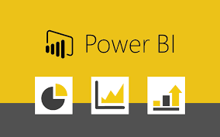

Tech stack Used
Understanding the Data
Bring in the dataset.
Examine the structure of the dataset.
Identify the types of data it contains.
Utilize Key Performance Indicators (KPIs) and appropriate tools.
Execute necessary actions based on the analysis.
Presentation of the Tasks

Slide 6
Task 1 : Data Exploration and Summary
Objective :
Understand and Summarize Key Statistics in the Dataset
Steps:
Data Import: Import the dataset into Power BI.
Exploratory Analysis: Explore the dataset structure and data types.
Calculate Statistics: Compute average age, percentage of individuals with various investments, and common savings objectives.
Visualization: Create charts for effective visualization of the summary statistics.

Slide 7
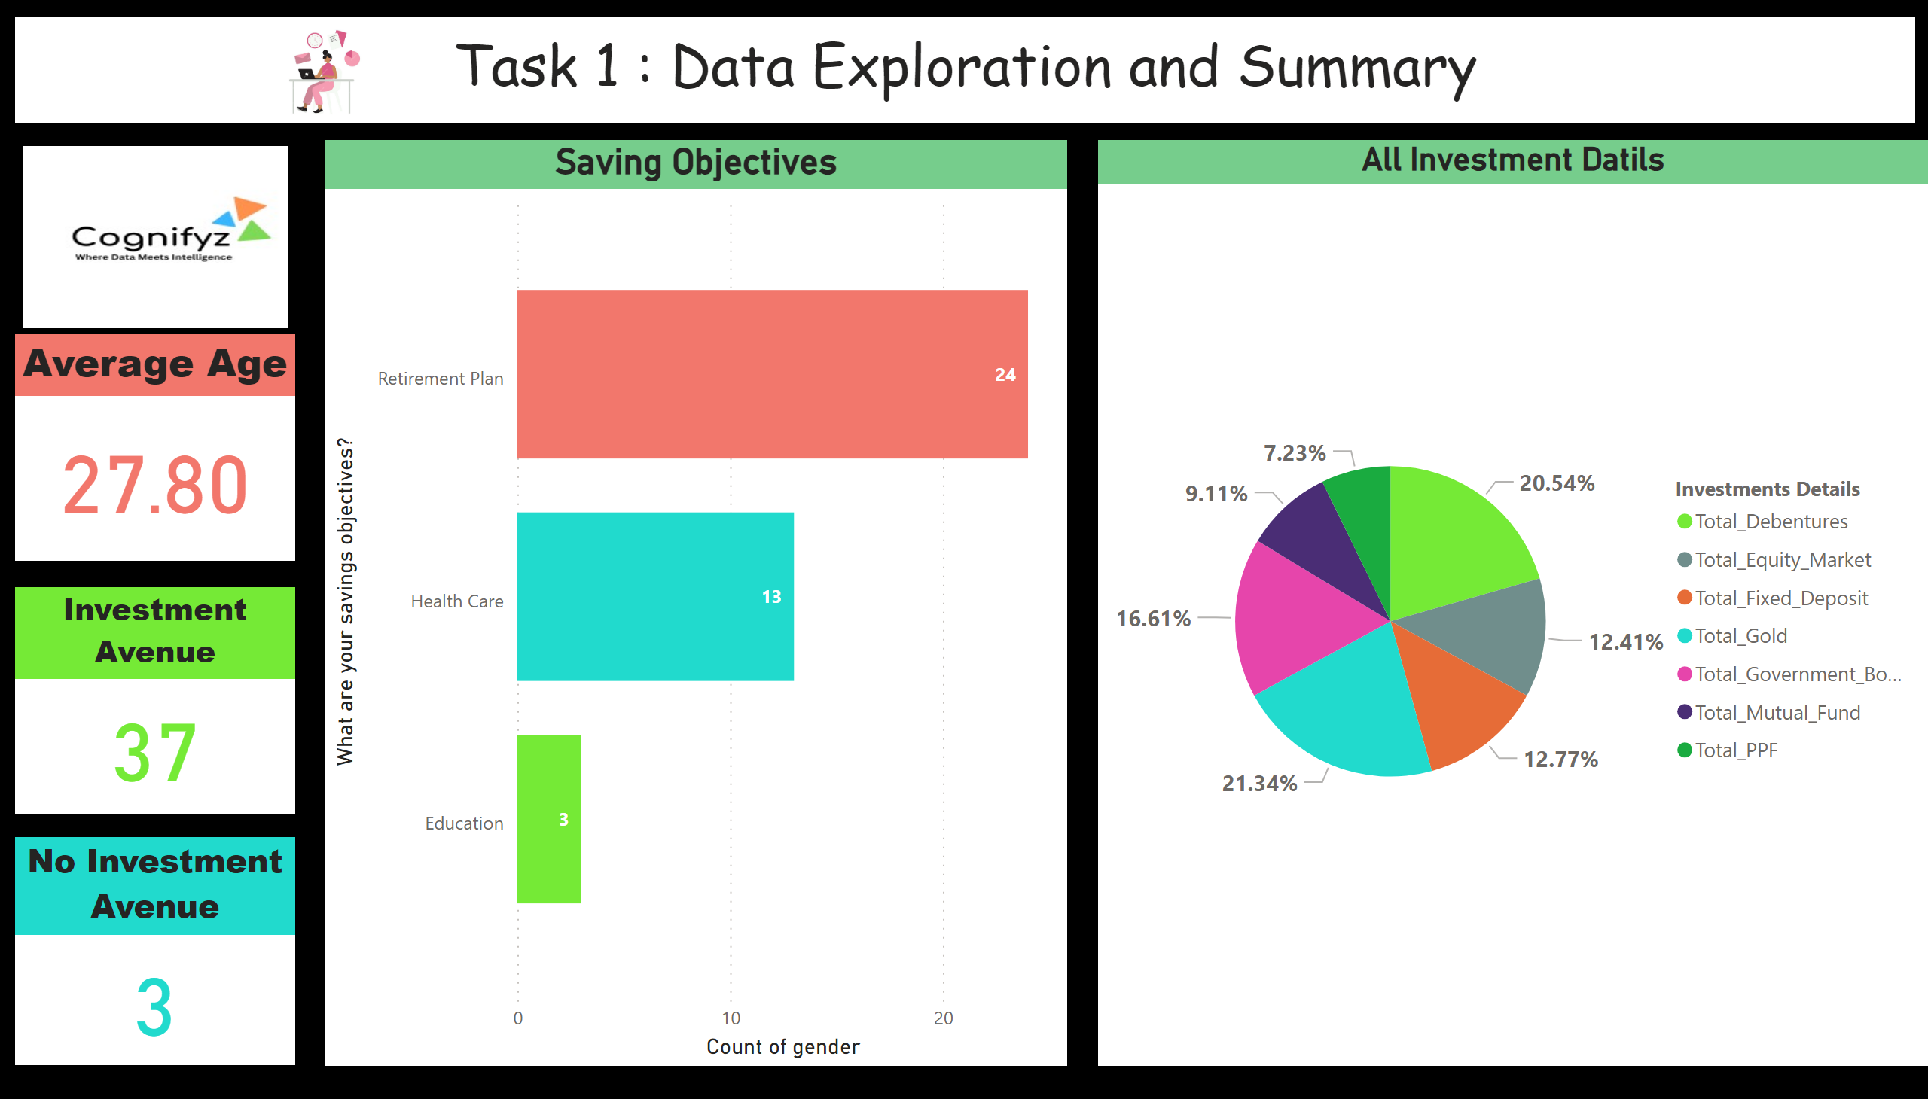
Task 1
Notes:
Average Age
No alt text provided
Saving Objectives
No alt text provided
Investment Avenue
No alt text provided
No Investment Avenue
No alt text provided
All Investment Datils
No alt text provided
textbox
No alt text provided
image
No alt text provided
image
No alt text provided

Slide 8
Task 2 : Gender-Based Analysis
Objective :
Analyze and Visualize Gender-Based Differences in Investment Preferences
Steps :
Visual Comparison: Create charts comparing investment choices (equity, mutual funds, government bonds) based on gender.
Insights: Derive insights from the visualizations, noting significant gender-based trends.

Slide 9
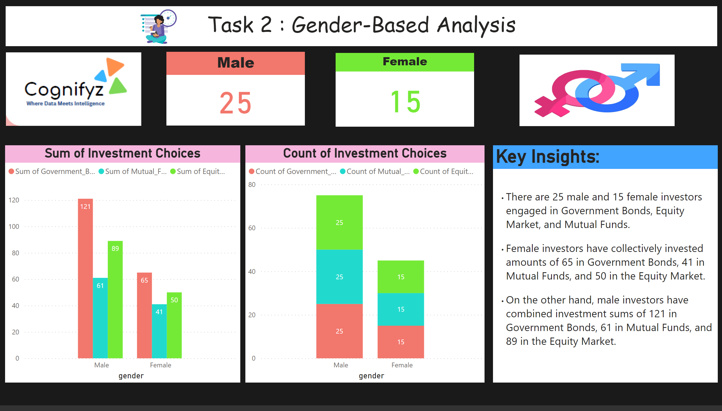
Task 2
Notes:
Male
No alt text provided
Female
No alt text provided
textbox
No alt text provided
image
No alt text provided
Sum of Investment Choices
No alt text provided
Count of Investment Choices
No alt text provided
Key Insights:
No alt text provided
image
No alt text provided
image
No alt text provided

Slide 10
Task 3 : Objective Analysis
Objective :
Analyze the Relationship Between Savings Objectives and Investment Choices
Steps :
Correlation Analysis: Explore the correlation between savings objectives (e.g., Capital Appreciation) and investment avenues (e.g., Equity).
Chart Creation: Generate charts displaying preferred investment choices for each savings objective.

Slide 11
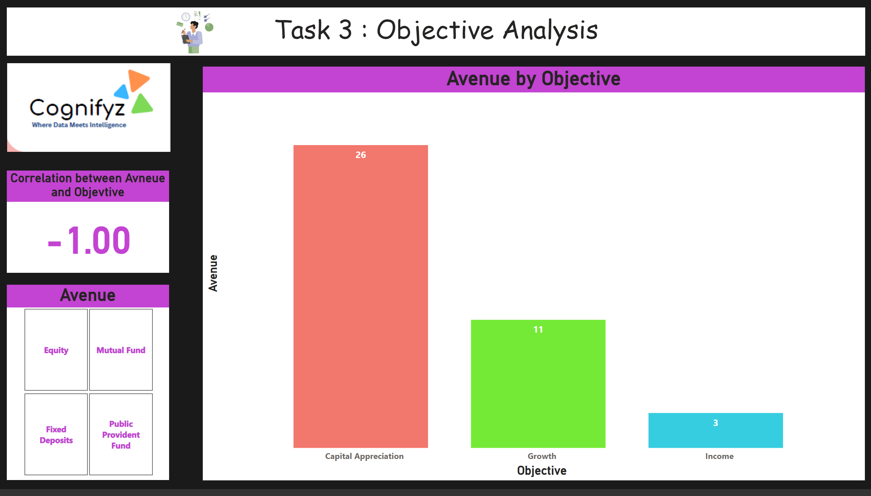
Task 3
Notes:
textbox
No alt text provided
image
No alt text provided
Correlation between Avneue and Objevtive
No alt text provided
Avenue by Objective
No alt text provided
Avenue
No alt text provided
image
No alt text provided

Slide 12
Task 4 : Investment Duration and Frequency
Objective :
Analyze Investment Durations and Monitoring Frequencies
Steps :
Duration Distribution: Visualize the distribution of investment durations.
Frequency Analysis: Examine investment monitoring frequencies and their impact on investment preferences.

Slide 13
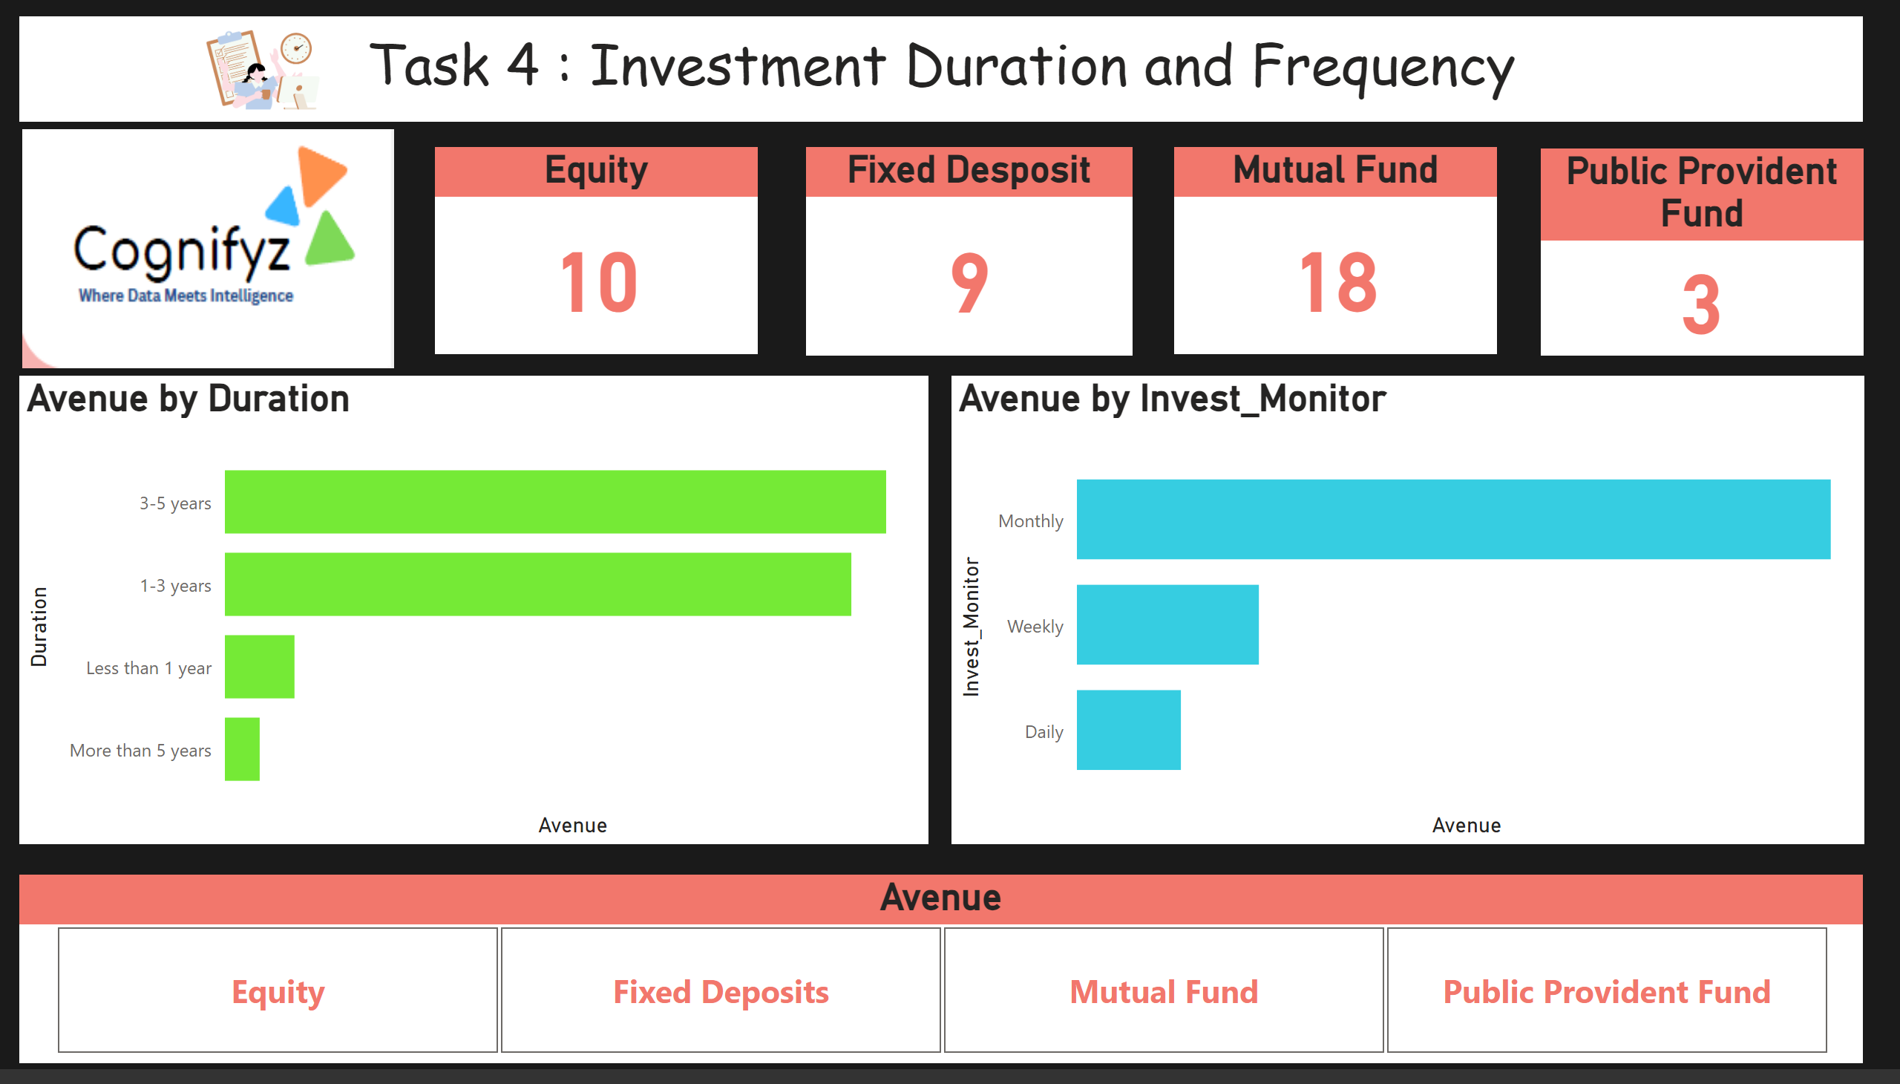
Task 4
Notes:
textbox
No alt text provided
image
No alt text provided
Avenue by Duration
No alt text provided
Avenue by Invest_Monitor
No alt text provided
Avenue
No alt text provided
Fixed Desposit
No alt text provided
Public Provident Fund
No alt text provided
Equity
No alt text provided
Mutual Fund
No alt text provided
image
No alt text provided

Slide 14
Task 5 : Reason for Investment
Objective :
Analyze and Visualize the Reasons for Investment
Steps :
Trend Analysis: Identify common trends in reasons for investment (e.g., Better Returns, Tax Benefits).
Visualization: Create charts showing the most frequently cited reasons for investing.

Slide 15
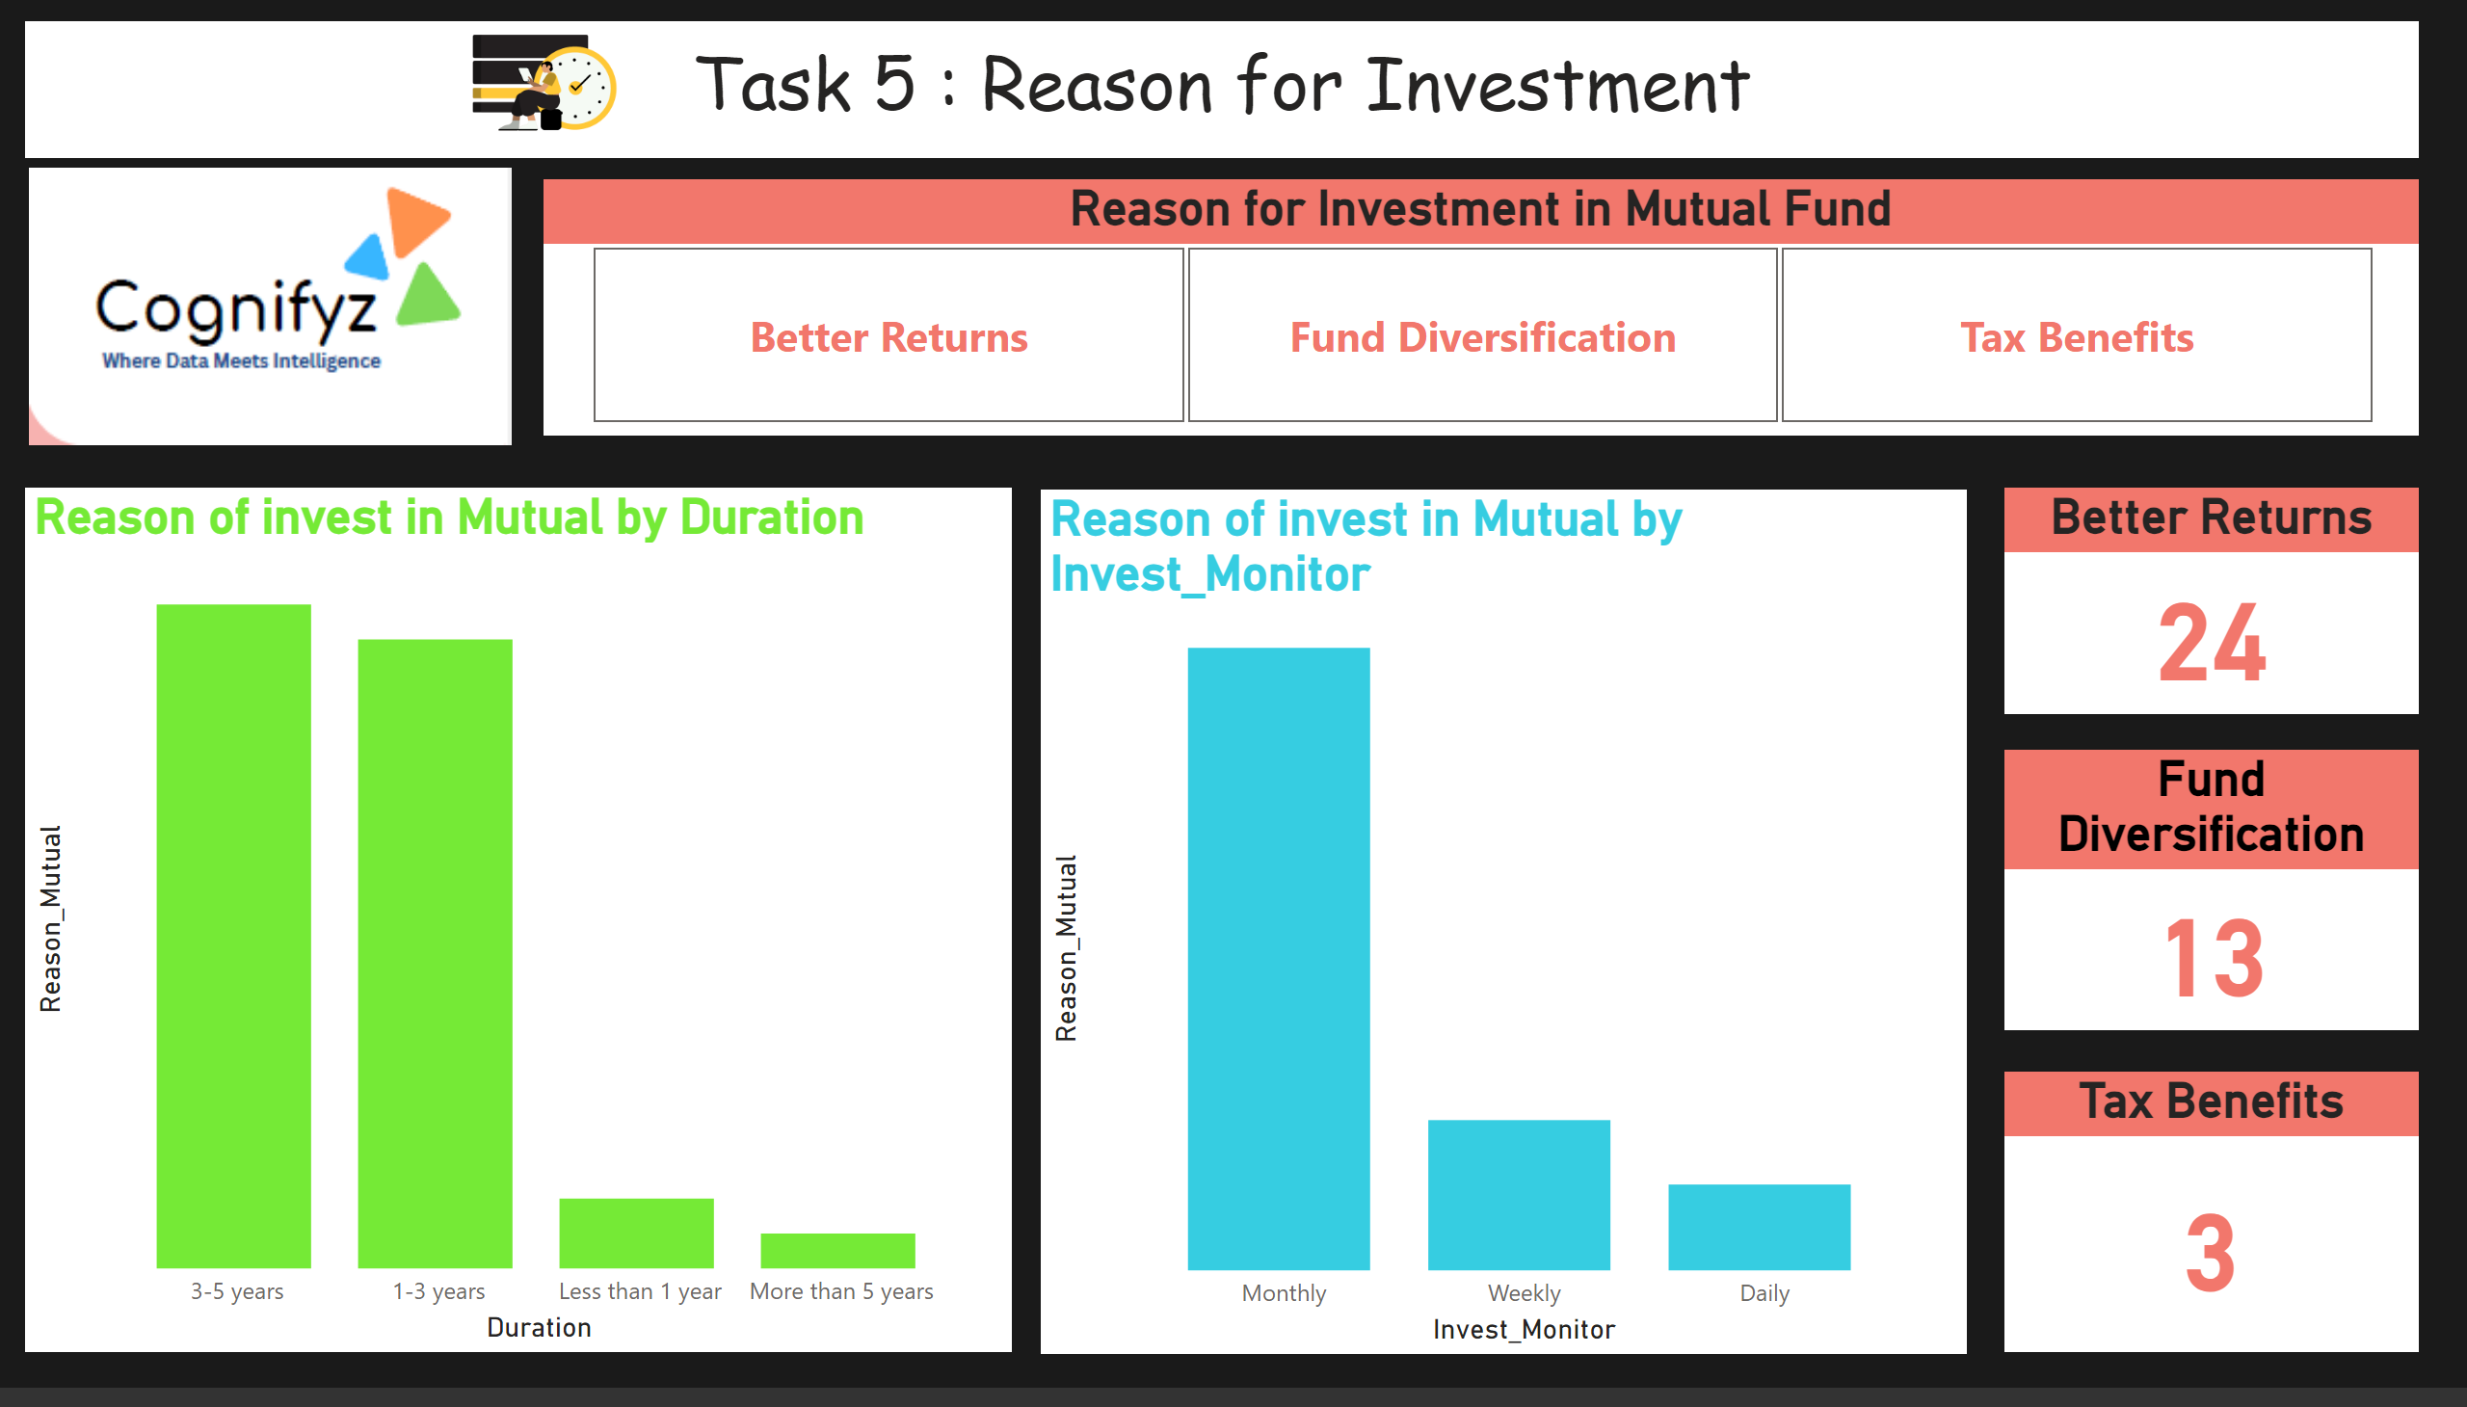
Task 5
Notes:
textbox
No alt text provided
image
No alt text provided
Reason of invest in Mutual by Duration
No alt text provided
Reason of invest in Mutual by Invest_Monitor
No alt text provided
Reason for Investment in Mutual Fund
No alt text provided
Better Returns
No alt text provided
Fund Diversification
No alt text provided
Tax Benefits
No alt text provided
image
No alt text provided

Slide 16
Task 6 :Source of Investment
Objective :
Analyze the Sources of Investment Information
Steps :
Source Analysis: Visualize where individuals get their investment information (e.g., Newspapers, Internet).
Insight Extraction: Analyze which sources are most commonly relied upon by investors.

Slide 17
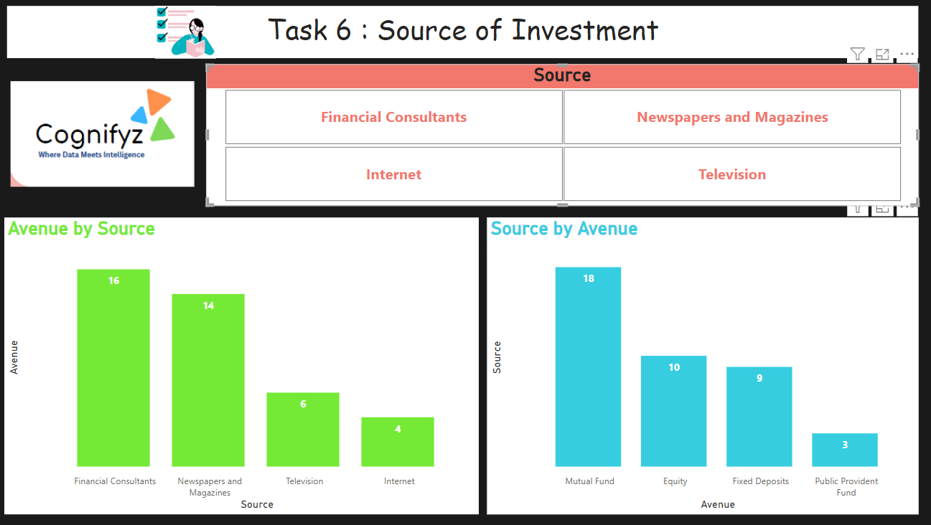
Task 6
Notes:
textbox
No alt text provided
image
No alt text provided
clusteredColumnChart
No alt text provided
Source
No alt text provided
Source by Avenue
No alt text provided
image
No alt text provided

Slide 18
Task 7 : Combine Insights into a Dashboard
Objective :
Create a comprehensive dashboard incorporating all insights
Steps :
Dashboard Design: Design an intuitive dashboard layout in Power BI.
Incorporate Insights: Include visualizations from all previous analyses in the dashboard.
Interactivity: Add interactive elements for exploring the data further.
Key Findings: Summarize major insights derived from the analysis.
Finalization: Polish the dashboard for a professional appearance and user-friendly experience

Slide 19
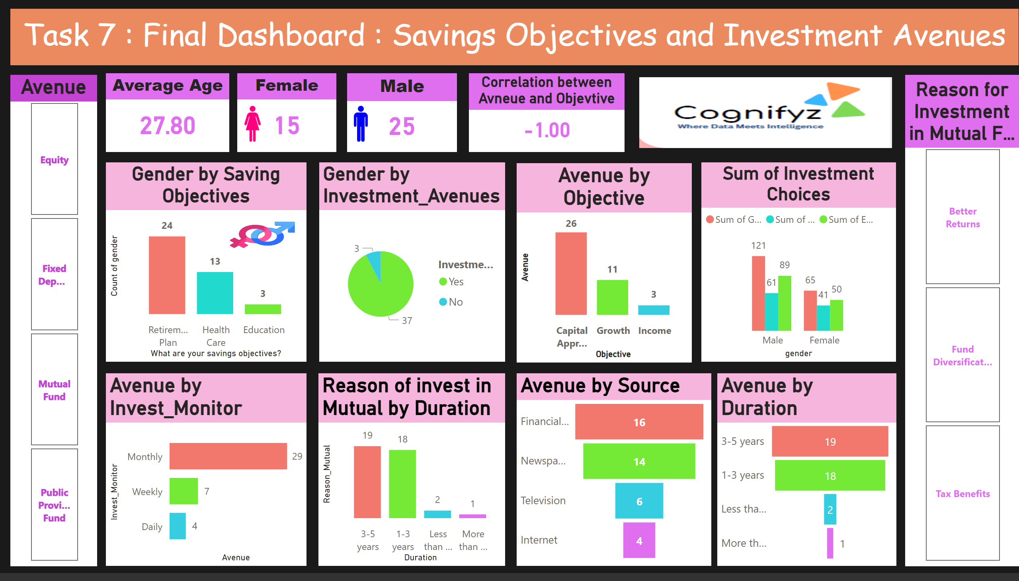
Task 7
Notes:
textbox
No alt text provided
image
No alt text provided
Gender by Saving Objectives
No alt text provided
Gender by Investment_Avenues
No alt text provided
Average Age
No alt text provided
Sum of Investment Choices
No alt text provided
Male
No alt text provided
Female
No alt text provided
Avenue by Objective
No alt text provided
Correlation between Avneue and Objevtive
No alt text provided
Avenue
No alt text provided
Avenue by Duration
No alt text provided
Avenue by Invest_Monitor
No alt text provided
Reason of invest in Mutual by Duration
No alt text provided
Reason for Investment in Mutual Fund
No alt text provided
funnel
No alt text provided
image
No alt text provided
image
No alt text provided
image
No alt text provided

Slide 20
Conclusion
Comprehensive Analysis: The project involved a thorough examination of client investment data, covering key statistics and various aspects of investment behavior.
Gender-Based Insights:Through visual comparisons, we gained valuable insights into gender-based differences in investment preferences, aiding in more targeted financial strategies.
Relationship Between Objectives and Choices: The correlation analysis provided clarity on the relationship between clients' savings objectives and their preferred investment avenues.
Duration and Monitoring Patterns:The project shed light on investment durations and monitoring frequencies, offering a nuanced understanding of client engagement with their investments.
Reasons and Information Sources: Trend analysis revealed common reasons for investment, while source analysis highlighted where clients predominantly gather information, providing actionable insights for communication strategies.
Enhanced Decision-Making: The findings from this project contribute to informed decision-making, enabling the optimization of investment offerings and improving overall customer satisfaction.

Slide 21
Thank You

